Slide 1

UCB Data Analysis Bootcamp Group Project 1 Dhwani, Eduardo, Johnathan, Justin July 2024

Slide 2


Crime Chronicles
Scope analysis of crime rate in California based on the changes in the rate of inflation.

Slide 3
Research Questions
How have crime rates in California changed from 1998 to 2023?
What are the long-term trends in different types of crime (e.g., violent crimes, property crimes) over this 25-year period?
Is there a correlation between annual inflation rates and overall crime rates in California over the past 25 years?
How does inflation impact different types of crime (e.g., theft, burglary, assault) over this period?
Are there specific regions in California where the correlation between inflation and crime rates is more pronounced over the 25-year period?
How do urban and rural areas differ in terms of crime rate trends and their correlation with inflation from 1998 to 2023?
How do other economic factors (e.g., unemployment rates, housing costs) interact with inflation to affect crime rates over the 25-year period?
How have policy changes aimed at controlling inflation affect crime rates in California from 1998 to 2023?
How do California’s crime and inflation correlation trends compare with national trends over the past 25 years.

Slide 4
Data Source:
Federal Bureau of Investigation (FBI), Uniform Crime Reports (UCR)
( http://www.fbi.gov/about-us/cjis/ucr/ucr )
Full Title: Number of Violent Crimes per 1,000 Population.
Short Title: Violent Crime Rate.
Contents
Tab | Description
ViolentCrime | Data on the violent crime rate for California at multiple geographical levels: city (PL), county (CO), region (RE), and state (CA)
DataDictionary | Description of all of the variables in the Violent Crime tab
MPO_CountyList | Description of the counties included in each of the Metropolitan Planning Organization regions (RE)
DataFilteringInstructions | Instructions on how to apply filters to navigate the data in the file

Slide 5
Data Cleanup and Exploration:

Slide 6
Data Analysis :
Refer to the Jupyter Notebook at :

Slide 7
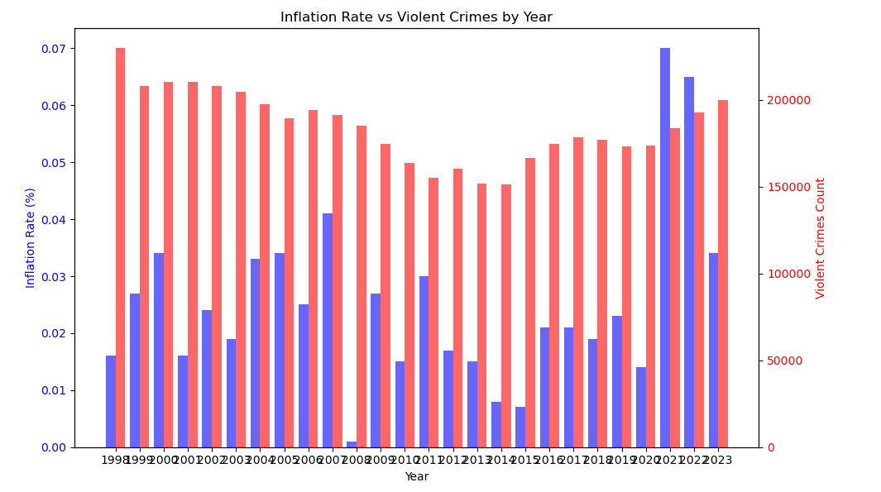
Is there a correlation between annual inflation rates and violent crime rates in California over the past 25 years?
Summary Analysis of Inflation Rate vs. Violent Crimes by Year (1998-2023)
The bar chart illustrates the relationship between the inflation rate and the number of violent crimes in the United States from 1998 to 2023. Key observations include:
General Trends:
Inflation Rate: High in the late 1990s, decreasing in the early 2000s, and relatively stable with a significant increase in the early 2020s.
Violent Crimes: Decreased from the late 1990s to the mid-2010s, then increased notably in the early 2020s.
Late 1990s to Early 2000s: High inflation rates coincide with high violent crime rates, which then decline as inflation decreases.
Mid-2000s to Early 2010s: Stable, lower inflation rates accompany a continued decline in violent crimes.
Mid-2010s to Early 2020s: Violent crimes remain low until a spike in the early 2020s, concurrent with rising inflation rates.
Early 2020s: A significant increase in both inflation and violent crimes suggests a potential direct correlation.
Conclusion
The data indicates a complex relationship between inflation and violent crime rates, with possible inverse correlation in earlier years and a direct correlation in recent years. Further analysis of additional economic variables is needed to fully understand this relationship.

Slide 8
Conclusion:

Slide 9
Reference :

Slide 10
Thank-You

